Slide 1
Records (structs) D.S Malik Book Chapter 11
Object Oriented Programming
Spring 2024

Slide 2
C++ data types
Simple
Structured
Arrays (collection of homogenous elements)
E.g., String: collection of characters
Records (Structs) (collection of heterogeneous elements)
Union
class

Slide 3
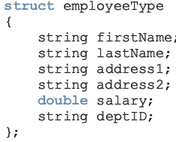
Records(structs)
Each value is a collection of components items
Entire collection is given a name (user defined data type)
Each component can still be accessed individually

Slide 4
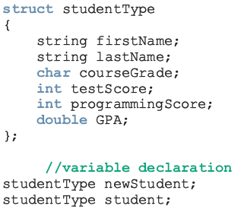
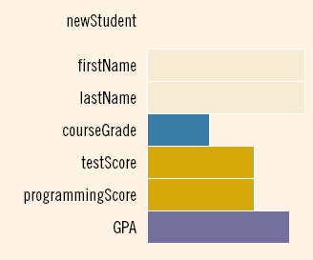
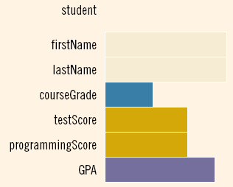
Variable declaration

Slide 5

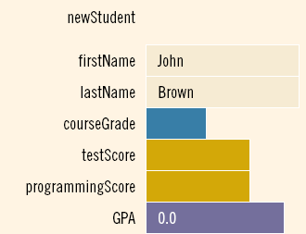

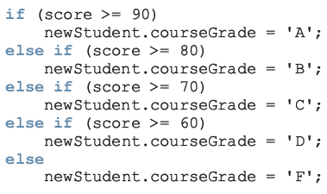
Accessing elements of struct
Example:
int score;

Slide 6

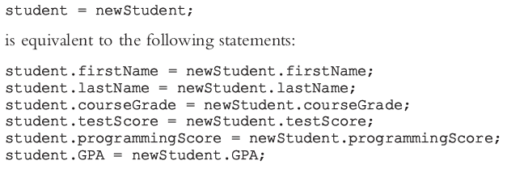
Assignment operator for structs
We can assign the value of one struct variable to another struct variable of the same type by using an assignment statement

Slide 7
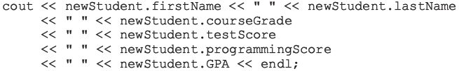
Comparison is done element by element
No aggregate input/output is allowed
cin>>newStudent; // illegal
cout<<newStudent; // illegal

Slide 8
Example: Student Report
#include <iostream>
#include <string>
using namespace std;
struct StudentReport
{
string st_name;
int marks;
char grade;
};
void main()
{
StudentReport s1,s2;
cout<<“\n Enter details of student \n”;
cin>>s1.st_name>>s1.marks>>s1.grade;
s2=s1;
}

Slide 9
Structs and functions
Arrays are passed by reference only and a function cannot return a value of type array
A struct variable can be passed as a parameter either by value or by reference
A function can return a value of type struct

Slide 10
Example: Student Report contd.
void ReadReport(StudentReport &s)
{
cout<<"\nEnter Student's name: ";
cin>>s.st_name;
cout<<"\nEnter Marks of student, out of 100: ";
cin>>s.marks;
s.grade=Calc_Grade(s.marks);
cout<<endl;
}
char Calc_Grade(int marks)
{
if(marks>=85)
return 'A';
else if (marks>=75)
return 'B';
else if (marks>=65)
return 'C';
else if (marks>=45)
return 'D';
else return 'F';
}

Slide 11
Example: Student Report contd.
void PrintReport(StudentReport s)
{
cout<<s.st_name;
cout<<s.marks;
cout<<s.grade;
}
void main()
{
StudentReport s1,s2;
ReadReport(s1);
PrintReport(s1);
s2=s1;
printReport(s2);
}
Struct variable has been passed by value

Slide 12
Good Programming Practice:
void PrintReport(const StudentReport &s)
{
cout<<s.st_name;
cout<<s.marks;
cout<<s.grade;
}

Slide 13
Struct returning function
Example
struct rational
{
int num;
int den;
};
void main()
{
Rational a,b,c;
a.num=1; a.den=2;
b.num=3; b.den=5;
c=product(a,b);
}
rational product (rational r1, rational r2)
{
rational temp;
temp.num=r1.num * r2. num;
temp.den=r1.den * r2. den;
return temp;
}

Slide 14
How to call following function?
void product (rational r1, rational r2, rational &r3)
{
r3.num=r1.num * r2. num;
r3.den=r1.den * r2. den;
}

Slide 15
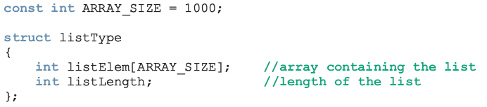
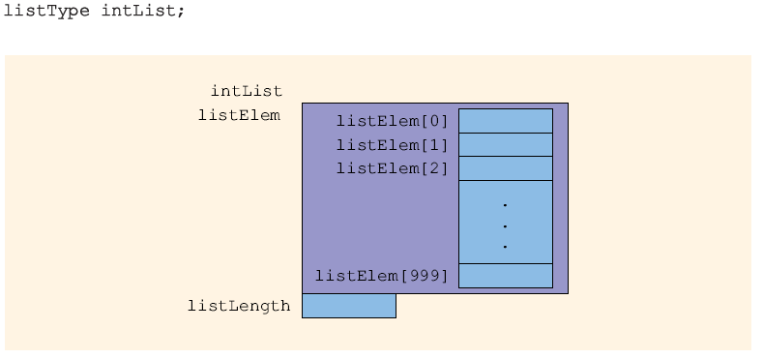
Arrays in structs

Slide 16
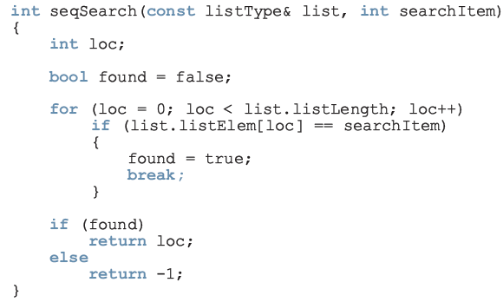

Slide 17
Arrays in structs contd.
struct StudentReport
{
string st_name;
int marks[5]; //stores marks of 5 courses
char grade[5]; //grades of 5 courses
};
void ReadReport(StudentReport &s)
{
cout<<"\nEnter Student's name: ";
cin>>s.st_name;
for(int i=0; i<5; i++)
{
cout<<"\nEnter Marks of all courses ";
cin>>s.marks[i];
s.grade[i]=Calc_Grade(s.marks[i]);
}
}

Slide 18
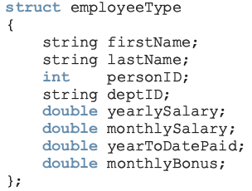
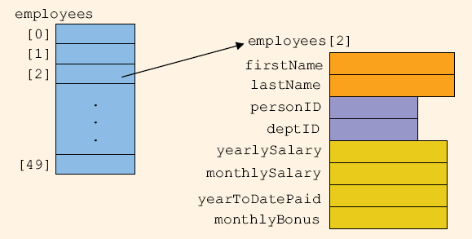
Struct in Arrays

Slide 19
Struct in Arrays contd.
struct StudentReport
{
string st_name;
int marks[5]; //stores marks of 5 courses
char grade[5]; //grades of 5 courses
};
void ReadReport(StudentReport &s);
void PrintReport(StudentReport s);
void main(){
StudentReport s[10];
for(int i=0; i<10; i++){
ReadReport (s[ i ] );
PrintReport (s[ i ] );
}
}
To store data of 10 students

Slide 20
Modifying readReport function using Filestreams
Let us assume we want to read data from file.
Implementation # 1 (Read data for all students)
void ReadReport(StudentReport s[], int NoOfStudents)
{
ifstream ifile;
int i=0;
ifile.open(“InputFile.txt”);
while(!ifile.eof()
{
if(i<NoOfStudents){
ifile>>s[i].st_name;
for(int j=0; j<5; j++)
{
ifile>>s[i].marks[j];
S[i].grade[j]=Calc_Grade(s[i].marks[j]);
}
i++;
}
}
void main(){
StudentReport s[10];
ReadReport (s, 10);
}

Slide 21
Input.txt
Name1 12 100 90 60 76
Name2 45 78 88 98 99

Slide 22
Implementation # 2 (Read data for one student at a time)
void ReadReport(ifstream & ifile, StudentReport &s)
{ifile>>s.st_name;
for(int j=0; j<5; j++){
ifile>>s.marks[j];
S.grade[j]=Calc_Grade(s.marks[j]);}}
void main(){
StudentReport s[10];
ifstream ifile;
ifile.open(“input.txt”);
for (int i=0 ; i <10; i++)
ReadReport (ifile, s[ i ] );
}
void main(){
StudentReport s[10];
ifstream ifile;
ifile.open(“input.txt”);
int i=0;
while(!infile.eof(){
ReadReport (ifile, s[ i ] );
i++;
}
}
OR

Slide 23
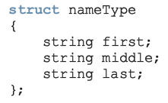
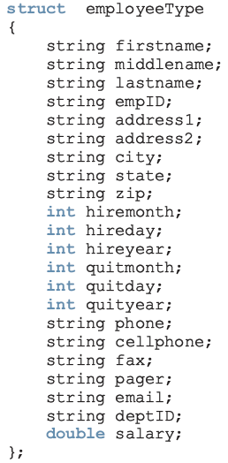
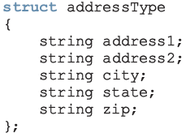
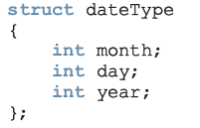
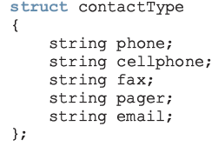
Struct within struct
repetition

Slide 24
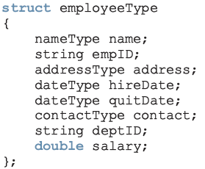
A better form of employeeType
Easier to manage
Some of this struct can be reused to build another struct
e.g., if we want to build a customer’s record. Every customer has a first name, last name and middle name, as well as an address and a way to be contacted

Slide 25
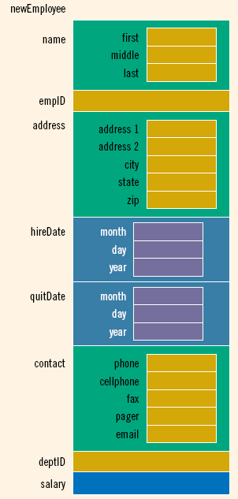
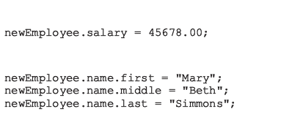

Slide 26
Example: StudentType
We want to implement a neon like system. For this purpose we need to store following information about each student.
Name, roll number, address (complete address, city , state , zip), Date of Birth, batch, discipline, total credits earned, cgpa, result of 5 courses.
We store following information about each course Result
Course Name, course code, credit hours, total marks, Grade
Our data is stored in two files:
One file has all the personal information about each student (Name, roll number, address (complete address, city , state , zip), Date of Birth, batch, discipline)
Other file has details of all 5 course except Grade
Assume both files are sorted by roll number. This means that personal data of the student with roll number 1 is first line of file1 and his/her courses details are in first line of file2.
We want to store details of 100 students.
Read data from file into arrays
Assume we are updating data for first semester students who have cgpa =0 and total credits =0
After reading data from both files, we want to update
Compute and update Grade of each course
Calculate and update Cgpa and total credits earned

Slide 27
Methodology
Identify structs
Make sample files
Identify all possible functions
Write prototypes
Use graphical approach

